Slide 1

Pharmacokinetics & Drug Dosing
Pharmacokinetics
Dosage adjustment in renal impairment
Dialysis removal of drugs

Slide 2
Ideal drug for a renal patient
Non-renal excretion
No side effects
Active drug
No renally excreted metabolites

Slide 3
Pharmacokinetics of Renal Failure
Bioavailability
Distribution
Metabolism
Elimination
Dialysis Modality
Notes:
4

Slide 4
Bioavailability
Definition : Amount of active drug in body
Affected by:
Altered gastro-intestinal motility
Increased gastric pH
Uraemia
Other medication e.g. phosphate binders
Notes:
Absorption reduced if drugs absorbed in an acidic envt
Absorption reduced by nausea & vomiting

Slide 5
Distribution
Altered by:
Hydration – oedema & ascites
Reduced protein binding - malnutrition
Changes in tissue binding
Notes:
Distribution increased by oedema & ascites (water soluble drugs)
Distribution reduced by dehydration & muscle wasting
High Vd with lipid soluble drugs.
Large Vd > 0.6L/kg

Slide 6
Protein Binding
Affected by:
pH
Binding inhibitors
Drugs or waste products
Competing drugs
Reduced plasma protein levels

Slide 7
Metabolism
To convert drugs to more water soluble forms so they can be more easily excreted
Reduced protein binding means more drug is available for metabolism
Uraemic toxins can induce hepatic enzymes causing an increased metabolism of some drugs
Notes:
Renal accumulation of toxic metabolites

Slide 8
Elimination Half Life
Definition: Time taken for free drug concentrations to
half
Depends on:
Glomerular filtration
Active tubular excretion
Passive tubular reabsorption

Slide 9

Drug Dosing
Loading Dose
Generally unchanged
Maintenance Dose
General rule - if a drug is normally excreted via the kidneys, its maintenance dose will need to be adjusted in patients with renal impairment.

Slide 10
Drug Dosing
There are two ways of doing this:-
Increase the dosing interval, dose remains unchanged
Decrease the dose, dosing interval remains unchanged
The objective is to produce a plasma drug profile which approaches that normally achieved in the absence of renal failure

Slide 11
Dose constant, Dosing Interval increased
------------ Teicoplanin 400mg every 72 hours
_______ Teicoplanin 400mg every 24hours
Log plasma concentration
0 1 2 3
Time (days)

Slide 12
Dose reduced, Dosing Interval unchanged
-----------Digoxin 62.5mcg Q 24 hrs
______ Digoxin 250mcg Q 24 hrs
Log plasma concentration
0 1 2 3
Time (days)

Slide 13

Where to look for Information
BNF ???
SPC
Renal Drug Handbook
Drug Prescribing in Renal Failure: Dosing Guidelines for Adults (Aronoff)
Drug company (remember to prod them!)
Clinical papers (usually case studies!)
SPC’s from other countries
Other colleagues

Slide 14

Take care with the following drugs
Low therapeutic window
Renally excreted e.g. aminoglycosides, digoxin
Active metabolites which are renally excreted e.g. morphine
Remember to increase doses of drugs as
renal failure improves.

Slide 15
Drugs to take care with in renal Impairment
Antibiotics especially penicillins and cephalosporins – lower dose is required, neurotoxic. Ciprofloxacin and macrolides cause nausea if the dose is too high. Lower doses with gentamicin and vancomycin
Antivirals e.g. aciclovir need to drastically reduce dose otherwise very neurotoxic and will become nauseas

Slide 16
Biological actions which may be altered in renal failure
Hypovolaemia: enhances antihypertensive effect: antihypertensives – start low dose but increase to maximum dose – Don’t believe the BNF!
Uraemia: can cause excess bleeding
Enhanced CNS sensitivity to centrally acting drugs e.g. analgesics especially opiates, antidepressants
Electrolyte variations e.g. digoxin toxicity

Slide 17
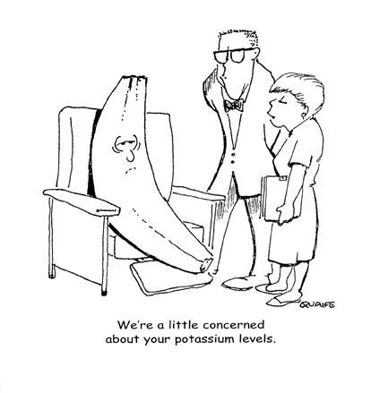
Biological actions which may be altered in renal failure
Hyperkalaemia: enhanced side effects with
ACE-I, ARB’s,
K⁺ sparing diuretics & potassium salts

Slide 18
Removal by intermittent dialysis
Haemodialysis:
Surface area, type & permeability of dialyser
Blood flow rate
Dialysate flow rate
Duration of dialysis
Drug: M Wt, Protein binding
Peritoneal Dialysis:
Concentration gradient between dialysate & plasma
Peritoneum permeability
Volume & frequency of exchanges
Drug: Vd, Protein binding, renal excretion
Notes:
HD: M Wt & PB
Pd: Low Vd, PB, Total renal excretion
Synthetic membranes bind larger drugs c/w modified cellulose
Small molecules by diffusion
Large molecules by convection

Slide 19
Drugs most likely to be dialysed:
Low molecular weight
(HD < 500 Da, HDF < 20,000 Da)
Low protein binding
Small volume of distribution (< 1 Kg/L)
Water soluble
Renally cleared (>50%)
Notes:
10
Albumin 60 Kda
Vd>2l/kg not likely to be dialysed
H₂0 soluble not removed as in plasma
Large molecules diffuse slowly

Slide 20
Removal by CRRT
Vd < 0.7L/kg
Molecular weight < 5000 Da
Protein binding < 80%
Route of excretion
UF rate
Type of dialyser
Blood flow rate
Sieving co-efficient (close to 1)
Notes:
Some exceptions e.g. digoxin
Small molecules by diffusion
Large molecules by convection
High Vd means most of drug is tissue bound and not available for removal
Amount removed= [UF] mg/L x UF rate L/min x time mins

Slide 21
Comparison of RRT

